Slide 1
ORD Policy Updates:
Technical Amendments to VHA Directives 1200.01, 1200.05, and 1200.08
Dial in (Main): (404) 397-1596
Attendee Access Code: 199-913-6133
Slides available on SharePoint:
See link in Q&A Box
C. Karen Jeans, PhD, CCRN, CIP
Director, Regulatory Affairs
ORPP&E
February 24, 2021

Slide 2
Objectives
Describe the purpose of technical amendments.
Describe ORD’s rationale for the technical amendments issued on January 8, 2021 to VHA Directives 1200.01, 1200.05, and 1200.08.
Identify the relationship between VHA Directive 1200.01’s technical amendments and the expiration of the discretionary hold on January 31, 2021 for three policy areas in VHA Directive 1200.01.

Slide 3
What are Technical Amendments?
Modifications to a published policy that
  Do not substantially change the policy,
  Correct grammar, style, punctuation and other minor matters to policy, and/or
  Clarify existing policy language by modifying policy language.
Require formal concurrence, but abbreviated concurrence process compared to non-technical amendments (e.g., major changes in existing policy) or new policies.
Issued with expectation of rapid implementation.

Slide 4

Timelines for Technical Amendments vs. Major Revisions/Revised Policy
9.5 months
VHA Directive 1200.05 January 7, 2019 Major Revision replacing VHA Handbook 1200.05
6 months
VHA Directive 1200.05 January 8, 2021
Technical Amendment #2
4 months
VHA Directive 1200.05 March 3, 2020
Technical Amendment #1

Slide 5
Summary of Technical Amendments: Number

Slide 6
Primary Purpose of Recently Issued Technical Amendments
VHA DIRECTIVE 1200.01
VHA DIRECTIVE 1200.05
VHA DIRECTIVE 1200.08
Resolution of issues related to the discretionary hold on three policy areas
Reinforcement that
prospective IRB approval is not required for emergency use of a test article
Alignment with NIH Guidelines for Research Involving Recombinant or Synthetic Nucleic Acid Molecules

Slide 7
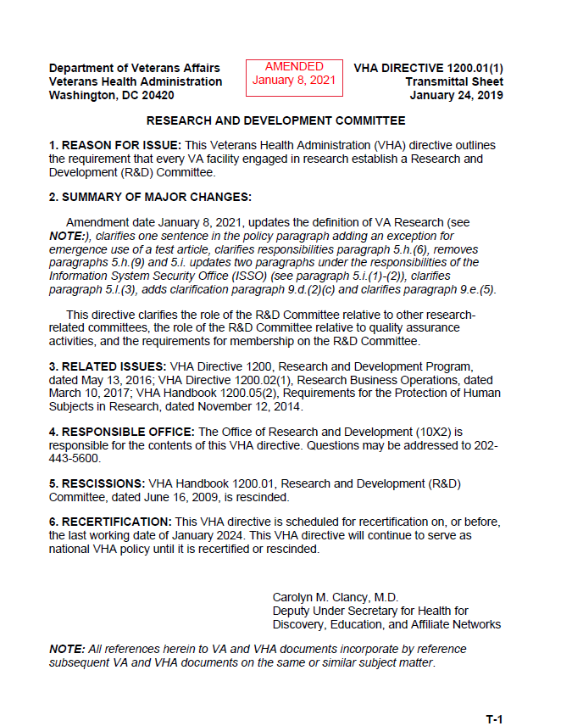
VHA Directive 1200.01(1)

Slide 8
Quick Guide for
VHA Directive 1200.01’s Technical Amendments
1. Clarifies that R&D Committee review and approval does not occur for emergency use of a test article.
2. Expands use of designated review process for expanded access activities.
3. Eliminates requirement for continuing review of exempt research activities.
4. Clarifies ISSO and PO reviews of VA research activities.
5. Eliminates requirements for establishment of R&D Conflict of Interest Committee to review the OGE Form 450 Alternative – VA, Research Financial Conflict of Interest Statement.
*Do not make the interpretation that elimination of ORD policy negates VA Investigator’s completion of OGE Form 450 Alternative-VA.

Slide 9
Itemization of Technical Amendments Published on January 8, 2021 to
VHA Directive 1200.01
Description of Amendment: Eleven revisions are present in the January 8, 2021 technical amendment to VHA Directive 1200.01. The amendments described in detail in the following tables are summarized as follows with revisions highlighted in red.
Paragraph 2: Revised summary of changes.
Paragraph 3.f: Added a “Note” to the definition of VA research to state that emergency use of a test article is VA research even though it does not require R&D Committee approval.
Paragraph 4: Clarified the “Scope” to state that R&D Committee approval is not required for emergency use of a test article.
Paragraph 5.h.(6): Removed the requirement that all research requires Privacy Officer review and clarified the scope of the ISSO review.
Paragraph 5.j: Clarified the ISSO review.

Slide 10
Itemization of Technical Amendments Published on January 8, 2021 to
VHA Directive 1200.01 (cont.)
Paragraphs 5.h.(9); 5.i., and 5.l.(3): Deleted
Paragraph 5.l.(4): Clarified the instruments used to conduct the ISSO reviews.
Paragraph 9.d.(2): Eliminated the requirement for continuing review of exempt research to align with elimination of continuing review for expedited research subject to the 2018 requirements.
Paragraph 9.e.(5): Clarified the use of designated review processes in expanded access.

Slide 11
VHA Directive 1200.01’s Technical Amendment:
Emergency Use of a Test Article
Issue requiring clarification: Confusion whether R&D Committee approval is required for emergency use of a test article
  The emergency use provision in the FDA regulations in 21 CFR Part 56.104(c) is an exemption from prior review and approval by the IRB.
  Individuals who receive test articles under FDA’s regulations under FDA’s emergency use provisions are human subjects.
  VA regulations in 38 CFR Part 17.85 for treatment of research related injuries applies to VA subjects in research approved by the Research and Development Committee.

Slide 12
VHA Directive 1200.01’s Technical Amendments:
Emergency Use of a Test Article (cont.)
Issue requiring clarification: Confusion whether R&D Committee approval is required for emergency use of a test article
Resolution:
  Policy clarified stating that emergency use of a test article is VA research even though it does not require R&D Committee approval.
  Policy clarified stating that R&D Committee approval is not required for emergency use of a test article.
  Applicable amendments
    Paragraph 3.f
    Paragraph 4

Slide 13
VHA Directive 1200.01’s Technical Amendments:
Expansion of Designated Review Process
Question requiring clarification: Can designated review be used for all expanded access uses of a test article?
  Single patient expanded access protocols approved by the IRB Chair or another appropriate IRB voting member were permitted to be approved using the R&D Committee’s designated review process.
  ORD’s position is that VA facilities should be given an option to use designated review approval for any type of expanded access use of a test article (investigational drug or unapproved medical device) approved by the IRB as described in FDA’s regulations.

Slide 14
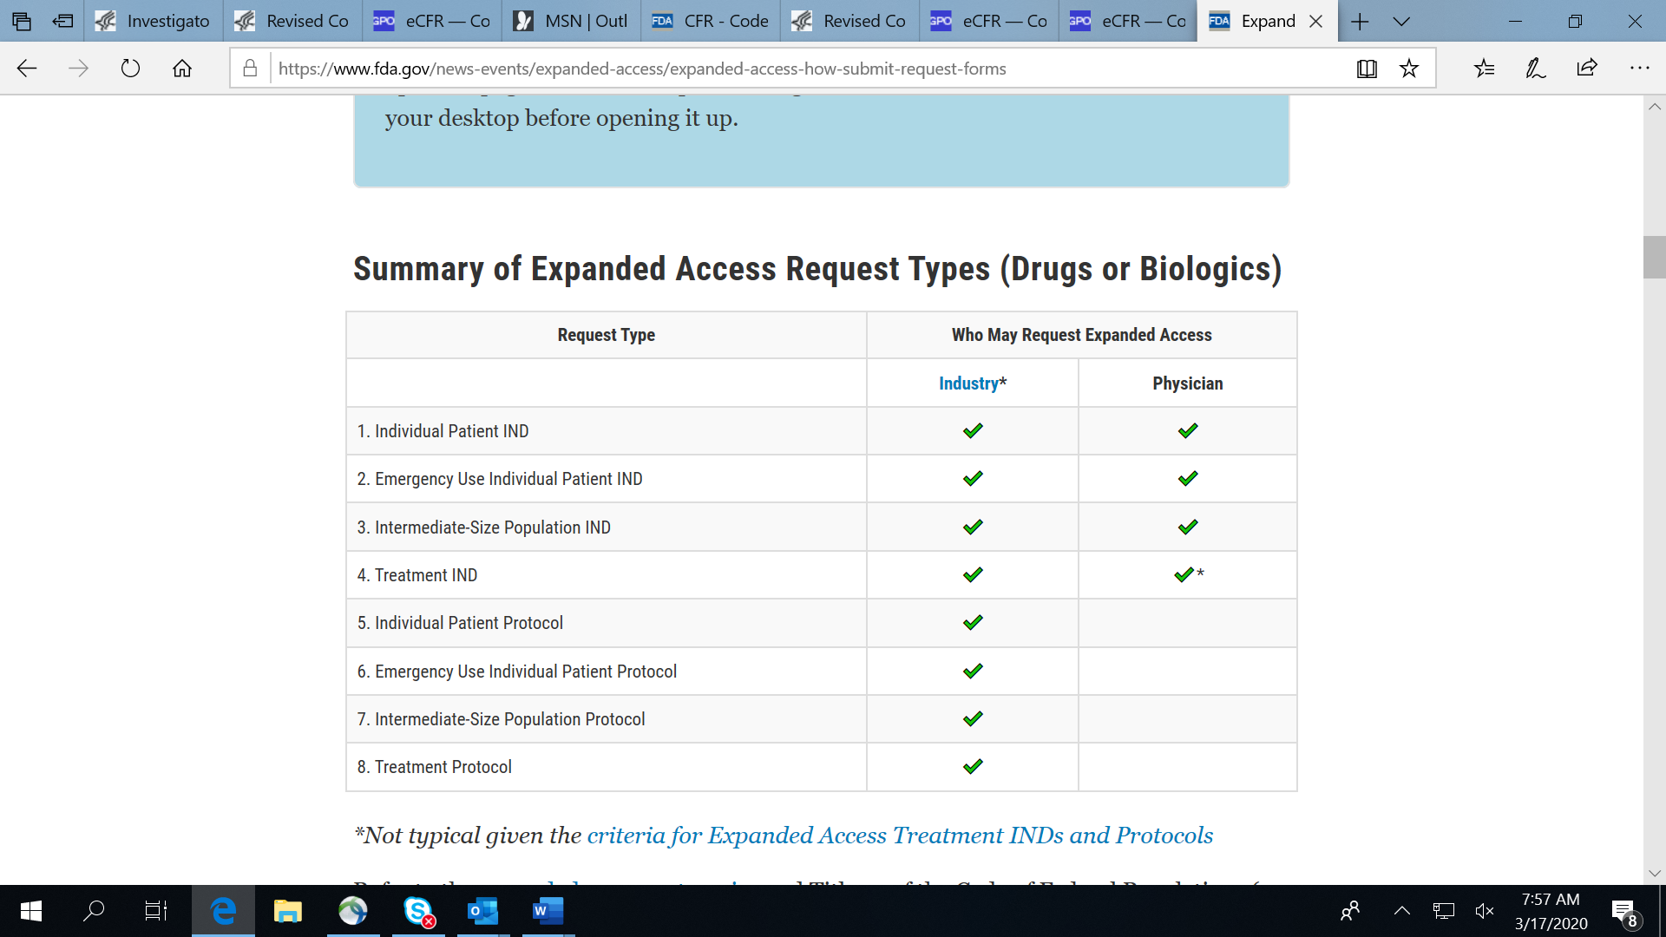
Summary of Different Types of Expanded Access: Drugs and Biologics
Source: https://www.fda.gov/news-events/expanded-access/expanded-access-how-submit-request-forms

Slide 15
VHA Directive 1200.01’s Technical Amendments:
Expansion of Designated Review Process (cont.)
Question requiring clarification: Can designated review be used for all expanded access uses of a test article?
Resolution:
  Revised policy to state that designated review could be used for any non-emergency expanded access protocols or activities approved by the IRB.
  Note also added that Emergency expanded access protocols or activities do not require prospective R&D Committee approval or notification
  Applicable amendment:
    Paragraph 9.e.(5)

Slide 16
VHA Directive 1200.01’s Technical Amendments:
Elimination of Continuing Review Requirement for Exempt Research (cont.)
Question requiring clarification: Can R&D Committees choose to eliminate continuing review for exempt studies when they are the sole oversight committee?
  The R&D Committee is required to conduct continuing review for all VA research activities when it is the only oversight committee.
  The revised Common Rule eliminated the requirement for continuing review of most minimal risk non-exempt human subject research activities specifically required with a justification by the IRB.
  ORD’s position is that continuing review of exempt research can be removed as a national ORD policy requirement. However, the exempt research remains under R&D Committee oversight.

Slide 17
VHA Directive 1200.01’s Technical Amendments:
Elimination of Continuing Review Requirement for Exempt Research (cont.)
Question requiring clarification: Can R&D Committees choose to eliminate continuing review for exempt studies when they are the sole oversight committee?
Resolution:
  Policy revised to state that “continuing review approval for exempt research is not required by the R&D Committee for continuing review following initial approval”.
  ORD wishes to reinforce that exempt research continues to require initial approval by the R&D Committee.
  Applicable amendment:
    Paragraph 9.d.(2)(c)

Slide 18
VHA Directive 1200.01’s Technical Amendments:
ISSO and PO Reviews
Issue requiring clarification: A discretionary hold had been put into place beginning in April of 2019 regarding policy statements in VHA Directive 1200.01 requiring ISSO and PO reviews for all VA research.
  VHA Directive 1605.01, Paragraph 5.n.(18) requires privacy officers to conduct a review of human study research protocols to ensure the privacy requirements are met. VHA Privacy policies do not require privacy officer reviews of all VA research, nor was it ORD’s intent to require it.
  All VA research do not require the same levels of ISSO reviews because all studies do not have the same types of information security issues, nor was it ORD’s intent to require it.

Slide 19
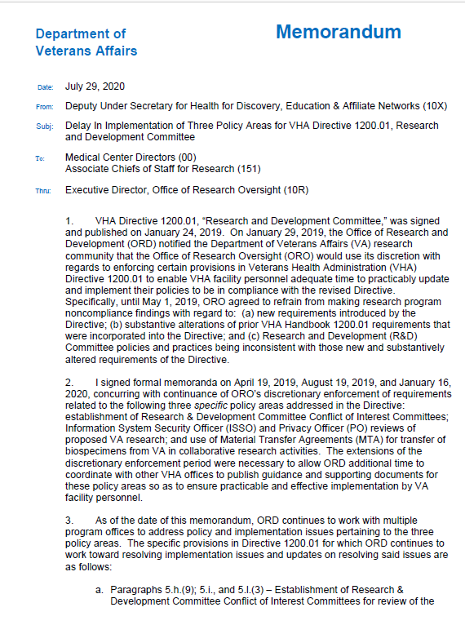
July 29, 2020: DUSH-DEAN Memorandum-
Delay in Implementation of Three Policy Areas for VHA Directive 1200.01
Fourth memorandum extending the discretionary hold on enforcement of three policy areas within VHA Directive 1200.01 that had been in effect since VHA Directive 1200.01 was issued.
Discretionary hold permitted on policies involving:
  R&D COI Committee
  ISSO and PO Reviews of all VA research – VA Facilities remained responsible for ensuring all human subjects research underwent ISSO and PO review prior to final R&D Committee approval
  Material Transfer Agreements for transfer of Biospecimens for Collaborative Research
Expired on January 31, 2021

Slide 20
VHA Directive 1200.01
Technical Amendments Related to ISSO and PO Reviews
Non-Amended VHA Directive 1200.01
Paragraph 5.RESPONSIBILITIES:
h.(6) Ensuring Information System Security Officer (ISSO) and Privacy Officer (PO) review is complete before a study is given final approval.
NOTE: The R&D Committee can approve contingent on ISSO and PO review.
Amended VHA Directive 1200.01
Paragraph 5.RESPONSIBILITIES:
h.(6) Ensuring Information System Security Officer (ISSO) review of studies that involve the collection, processing, storage, and transmission of research data and Privacy Officer (PO) review of studies using human data are complete before a study is given final approval.
NOTE: The R&D Committee can approve contingent on ISSO and PO review.

Slide 21
VHA Directive 1200.01
Technical Amendments Related to ISSO and PO Reviews
Non-Amended VHA Directive 1200.01
Paragraph 5. RESPONSIBILITIES:
l(4) Submitting and implementing plans for data use, storage, and security to the PO and ISSO that are consistent with VHA Directive 1605.01, VA Directive 6500, implementing handbooks, and other legal requirements.
Amended VHA Directive 1200.01
Paragraph 5.RESPONSIBILITIES:
l(3) Submitting and implementing the VHA Research Protocol Privacy Review Checklist and OIS Enterprise Research Data Security Plan for data use, storage, and security that are consistent with VHA Directive 1605.01, VA Directive 6500, implementing handbooks, and other legal requirements.

Slide 22
VHA Directive 1200.01
Technical Amendments Related to ISSO Reviews
Non-Amended VHA Directive 1200.01
Paragraph 5. RESPONSIBILITIES:
j. The ISSO is responsible for ensuring that the proposed research complies with information security requirements for VA sensitive information (see VA Handbook 6500, Managing Information Security Risk: VA Information Security Program, dated September 20, 2012).
Amended VHA Directive 1200.01
Paragraph 5.RESPONSIBILITIES:
i. The ISSO is responsible for:
(1) Ensuring that the proposed research complies with information security requirements for VA research data; and
(2) Participating in the Institutional Review Board (IRB) protocol review and approval process, evaluating the study’s data usage, and making recommendations to ensure implementation of reasonable safeguards for the data as determined within the Office of Information Security (OIS) Research Support Division (RSD) developed Enterprise Research Data Security Plan (ERDSP)

Slide 23
VHA Directive 1200.01’s
Technical Amendments Related to ISSO and PO Reviews (cont.)
Align the Privacy officer reviews with VHA Directive 1605.03.
Clarify the scope of ISSO reviews for VA research projects through use of tools.
Applicable amendments:
  Paragraph 5.h.(6)
  Paragraph 5.j
  Paragraph l.(3)

Slide 24
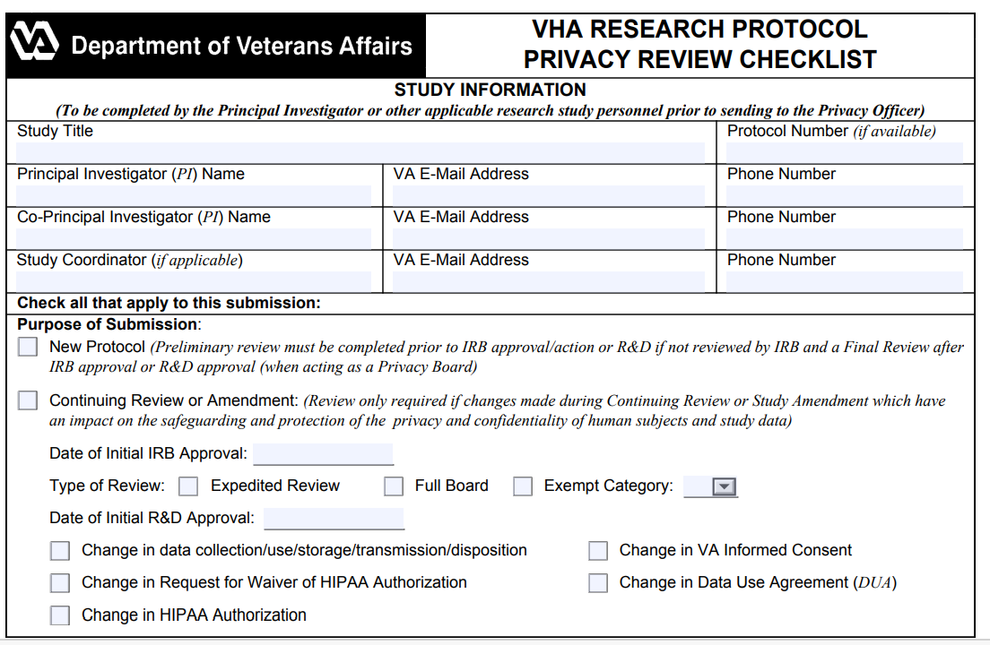
VA Form 10-250: VHA Research Protocol Privacy Review Checklist

Slide 25
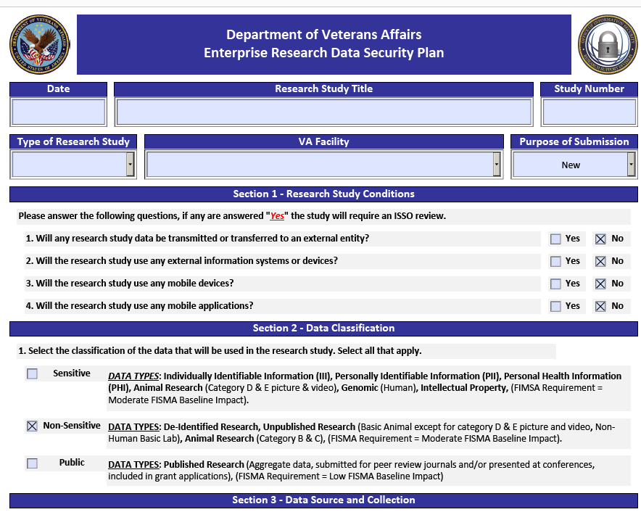
Enterprise Research Data Security Plan (ERDSP)

Slide 26
Where is the ERDSP located in VAIRRS?
Both the ERDSP tool and user guide can be found in the VAIRRS libraries under forms and templates.
  VHA ORPP&E, Washington, DC – Documents for Animal Committee Members
  VHA ORPP&E, Washington, DC – Documents for Human Subjects Committee Members
  VHA ORPP&E, Washington, DC – Documents for Safety and Biosafety Committee Members
  VHA ORPP&E, Washington, DC – Documents for Research and Development Committee Members

Slide 27
Where is the ERDSP located for VA Facilities not current using VAIRRS?
For VA R&D facilities that have not transitioned to using VAIRRS, both the ERDSP tool and user guide are available within the following repositories:
ORD Toolkit: Research Information Security & Cybersecurity
(2) OIS Research Support Division Public Documents

Slide 28
VHA Directive 1200.01’s Technical Amendments Related to ISSO and PO Reviews:
Key Points
For purposes of ISSO review, the responses on the ERDSP determine the level of ISSO review.
ISSOs are not required to attend IRB meetings, nor is there an ORD requirement for the IRB to document ISSO participation in an IRB review.
ISSO reviews of any study submitted to the IRB is required.

Slide 29
VHA Directive 1200.01’s Technical Amendments:
Transition Period to Use the ERDSP
The OIS Research Support Division (RSD) is preparing to release a role-based training bulletin to provide guidance on the phased transition towards fully using the ERDSP toolset and complying with ISSO review requirements within VHA Directive 1200.01.
Until a series of role-based training & awareness has been provided to the field, sites can continue to use their local procedures and/or research information security templates/checklists in the interim until the transition is complete.

Slide 30
VHA Directive 1200.01’s Technical Amendments:
R&D Conflict of Interest Committee and Investigator Conflict of Interest Policies
Issue requiring clarification: A discretionary hold had been put into place beginning in April of 2019 regarding policy statements in VHA Directive 1200.01 requiring formation of a R&D Conflict of Interest Committee to review the OGE Form 450 Alternative – VA, Research Financial Conflict of Interest Statement submitted by VA investigators.
  The policy also included as part of VA Investigator responsibilities when he or she was to file the OGE Form 450 Alternative-VA.
  The policy was put in during the final concurrence process because no formal “policy” referenced the use of OGE Form 450 Alternative-VA.
  The policy did not include sufficient direction on how the R&D COI committee was to be constituted, including its operations.

Slide 31
VHA Directive 1200.01’s Technical Amendments:
R&D Conflict of Interest Committee and Investigator Conflict of Interest Policies (cont.)
OGE Form 450 Alternative-VA was released in 2013 by VA OGC EST for VA Investigators.
All VA Facilities were instructed per the Dean-DUSH that they “. . . should continue following their procedures developed prior to the release of the revised VHA Directive 1200.01 for identifying and managing financial conflicts of interest for VA Investigators, including filing of the Alt 450s by VA Investigators conducting VA research.”

Slide 32
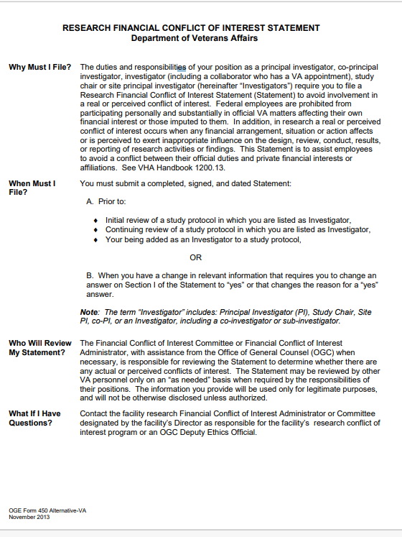
OGE Form 450-Alternative VA:
Research Financial Conflict of Interest Statement

Slide 33
VHA Directive 1200.01’s Technical Amendments:
R&D Conflict of Interest Committee and Investigator Conflict of Interest Policies (cont.)
The technical amendments removed the policy sections applying to the R&D Conflict of Interest Committee and VA Investigator policies related to submission of the OGE Form 450-Alternative VA.
Applicable amendments:
  Deleted Paragraphs 5.h.(9); 5.i., and 5.l.(3)

Slide 34
VHA Directive 1200.01’s Technical Amendments:
R&D Conflict of Interest Committee and Investigator Conflict of Interest Policies (cont.)
Removal of the policy sections is not to be interpreted as
  Permission for VA Investigators to stop using the OGE Form 450-Alternative VA.
  Permission to disregard federal ethics laws regarding financial conflict of interest
  Permission to remove your VA Facility’s Financial Conflict of Interest Administrator or to dissolve the VA Facility’s conflict of interest review committee (as applicable)
OGC EST has been working with ORD and OGC STAR with development of a separate research financial conflict of interest Directive.

Slide 35
Expiration of the Discretionary Hold: January 31, 2021
The DEAN-DUSH’s discretionary hold on the three policy areas within VHA Directive 1200.01 expired on January 31, 2021. The hold involved the policies applicable to:
  ISSO and PO reviews
  R&D Conflict of Interest Committee and reviews of OGE Form 450-Alternative VA
  Material Transfer Agreements for transfer of biospecimens in collaborative research

Slide 36
VHA Directive 1200.01:
Material Transfer Agreements (MTA)
VHA Directive 1200.01, Paragraph 10.c. requires use of a MTA in the absence of another agreement when biospecimens are transferred in a VA research collaborative research activity as stated:
  Biospecimens. The protocol, addendum, and/or subcommittee application must describe the applicable collection, use, transfer, and disposition of biospecimens obtained or collected. A Material Transfer Agreement (MTA) must be used to transfer biospecimens from VA unless the biospecimens’ transfer is addressed in another agreement executed between VA and the receiving institution or party, such as a CRADA, subaward, or MOU. NOTE: If a CRADA is executed for a research study where the scope of work specifically describes analysis, retention, and disposal of biospecimens by a central laboratory, then an MTA is not required.

Slide 37
VHA Directive 1200.01:
Material Transfer Agreements (MTA)
ORD policy applies to collaborative research activities.
  MTAs are not required when another type of agreement is in place related to the collaborative research activity.
  ORD does not require use of the VA MTA template, but it is encouraged because it simplifies the review process, particularly when VA is the provider.
  The VA MTA template (July, 2020) is located on ORD’s Technology Transfer website.
  The VA MTA template can be used when VA is the provider or the recipient of materials.
  VA Principal Investigators cannot sign the MTA as a signatory official on behalf of the VA, but signs as an acknowledging party.

Slide 38
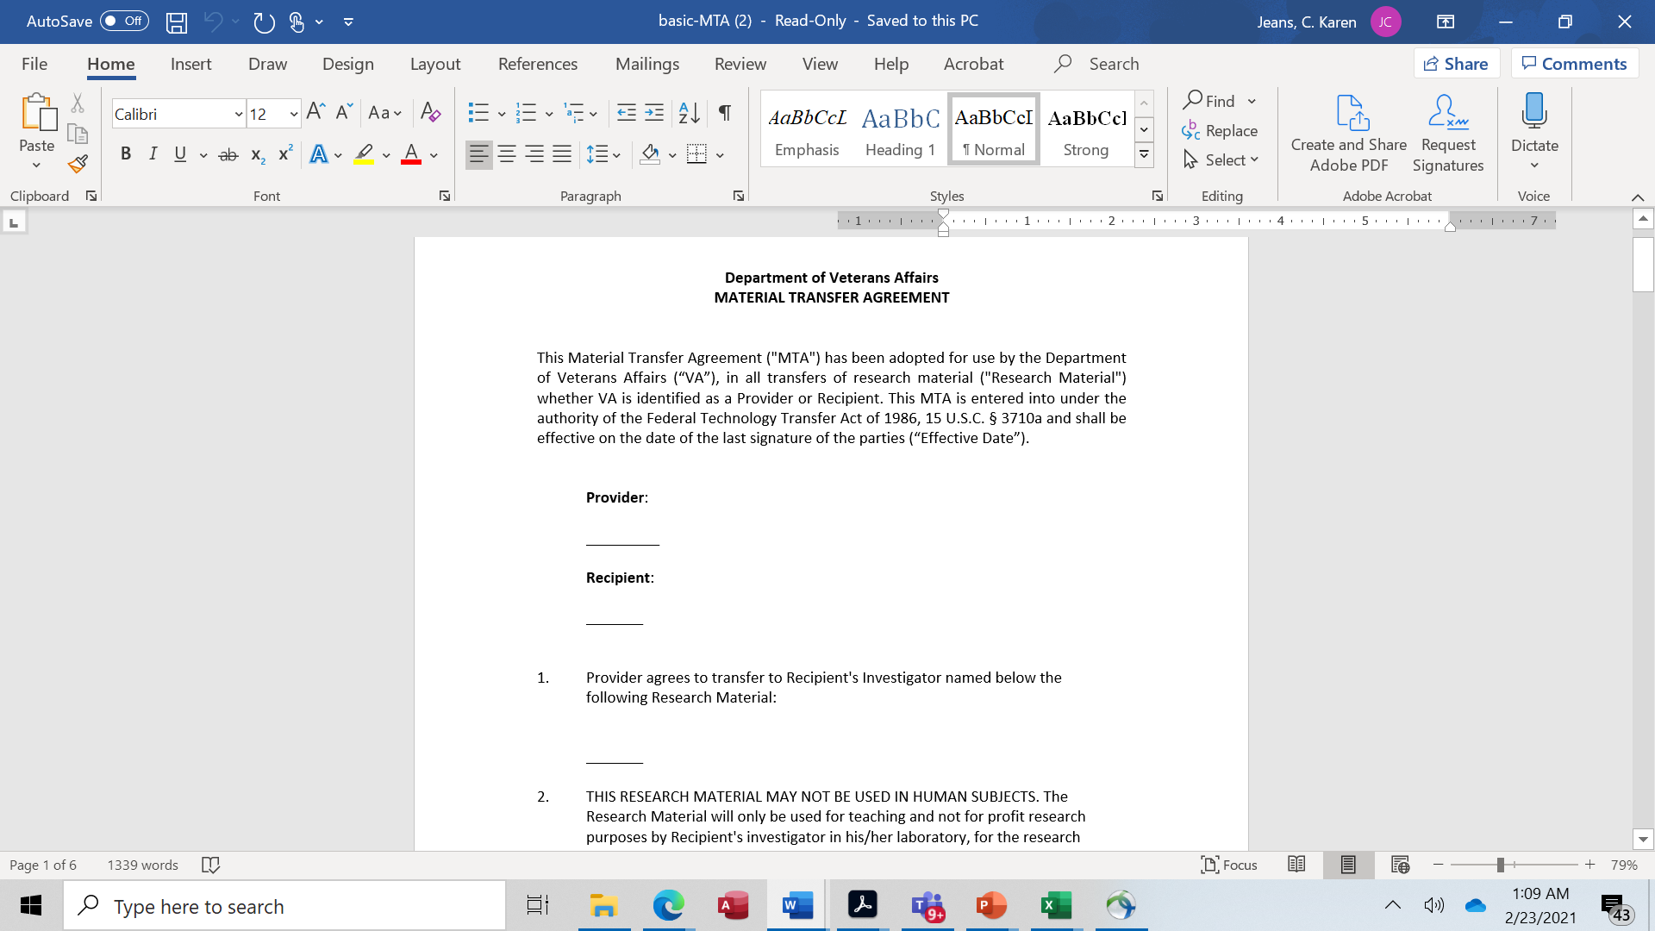
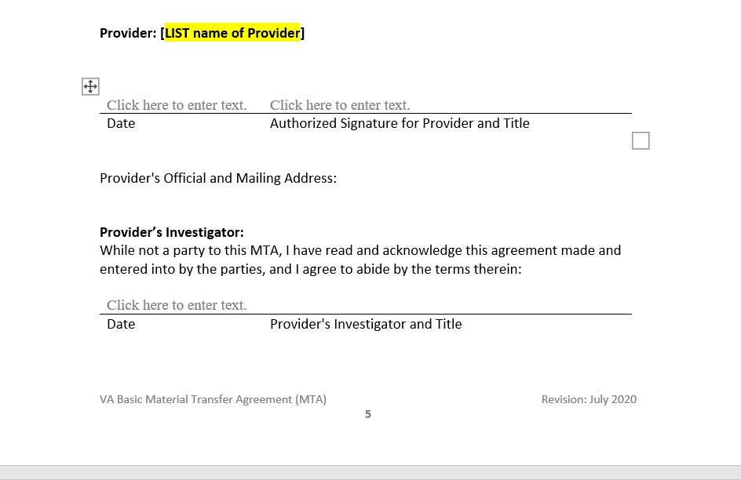
VA Material Transfer Agreement Template (July, 2020)
Forms, Templates and Model Agreements (va.gov)

Slide 39
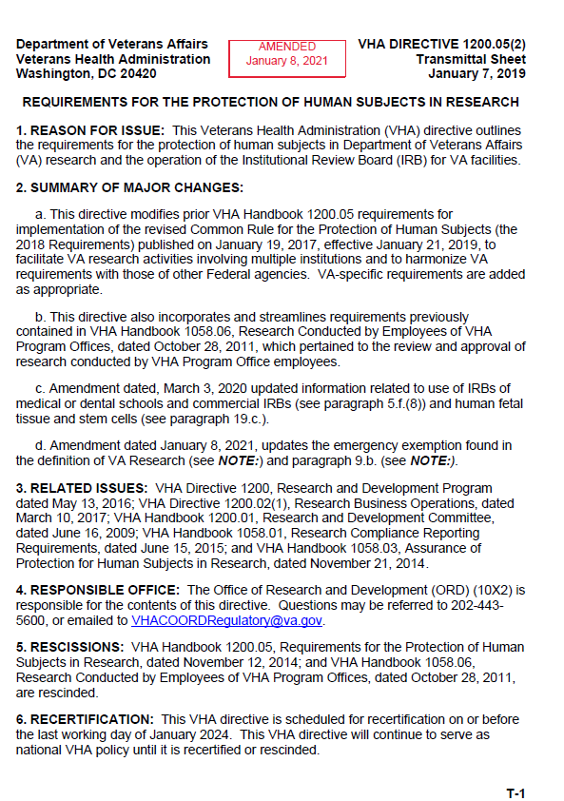
VHA Directive 1200.05(2)

Slide 40
Quick Guide to
VHA Directive 1200.05’s Technical Amendments
Clarifies that emergency use of a test article under FDA’s regulations does not require prospective IRB approval.
Clarifies that R&D Committee approval is not required for an emergency use of a test article.
VHA Directive 1200.01’s technical amendments contain the same clarifications.

Slide 41
Itemization of Technical Amendments Published on January 8, 2021 to
VHA Directive 1200.05
Description of Amendment: Three revisions are present in the January 8, 2021 technical amendment to VHA Directive 1200.05. The amendments described in detail in the following tables are summarized as follows with revisions highlighted in red.
Paragraph 2: Revised summary of changes.
Paragraph 3.f: Added a “Note” to the definition of VA research to state that emergency use of a test article is VA research even though it does not require R&D Committee approval.
Paragraph 9: Clarified that prospective IRB review and approval is not required for emergency use of a test article.

Slide 42
When is IRB and/or R&D Committee Review or Approval Required When a VA Physician Wants to Request an Investigational Drug or Biologic Through
FDA’s Expanded Access Regulations?
No Prospective IRB Approval
IRB Notification Required 5 Working Days After Beginning Administration
No VA Research and Development Committee approval
Emergency Use of a Test Article
Prospective IRB Approval Required
Prospective VA Research and Development Committee approval Required
R&D Committee can use Designated Review for any non-emergency expanded access protocols or activities approved by the IRB.
Non-Emergency Expanded Access of a Test Article

Slide 43

Emergency Use Authorization vs. Expanded Access Regulations
Use of an Investigational Drug or Biologic under an Emergency Use Authorization
Use of an Investigational Drug or Biologic under FDA’s Expanded Access Regulations

Slide 44
Differences Between Expanded Access -Investigational New Drug Applications (INDs)/Investigational Device Exemptions(IDEs) and
Emergency Use Authorizations (EUA)
Expanded Access: Investigational (IND or IDE) | Emergency Use Authorization (EUA) Investigational: No IND or IDE
Description: The objective of the IND/IDE is to assess the safety and efficacy of an investigational drug/biologic/device (hereafter “investigational product”) while ensuring that human subjects are protected during the research study of the investigational product. Investigational protocols specify requirements to ensure participant protection and the validity of the data collected during the clinical trial. | Description: Congress created the EUA in the Project BioShield Act of 2004 to give the public health system access to a greater range of medical products during a declared emergency. The EUA mechanism provides appropriate participant protections based on the circumstances of the emergency. EUAs are intended to allow for faster use of a product than under an IND/IDE.
FDA Approval: FDA review and agreement that the expanded access use or protocol may proceed (exception in some circumstances involving emergency use of an unapproved medical device). | FDA Approval: FDA is required to review and approve the request for EUA.
Institutional Review Board (IRB): Requires IRB review and approval unless emergency use (notification required). | IRB: Not applicable - does not require IRB review and approval.
Informed Consent: Requires written signed and dated informed consent (unless an exception from informed consent applies as per 21 CFR 50.23(c)). | Informed Consent: Distribution of information (e.g., fact sheets) for healthcare professionals and recipients that contains information on product safety, available alternative products, and the right to refuse administration of the EUA product is required.

Slide 45
Differences Between INDs/IDEs and Emergency Use Authorization (EUA) (cont.)
Investigational Protocols (IND and IDE) | Emergency Use Authorization (EUA)
Recordkeeping & Access: Requires recordkeeping and access to distribution and administration records. | Recordkeeping & Access: Recordkeeping and access to product distribution and administration records required at the discretion of the FDA commissioner.
Duration of Approval: Length of the clinical investigation or use. | Duration of Approval: Up to one year from the date of the declaration of emergency or for as long as the §564 emergency declaration is in effect, whichever is shorter.

Slide 46
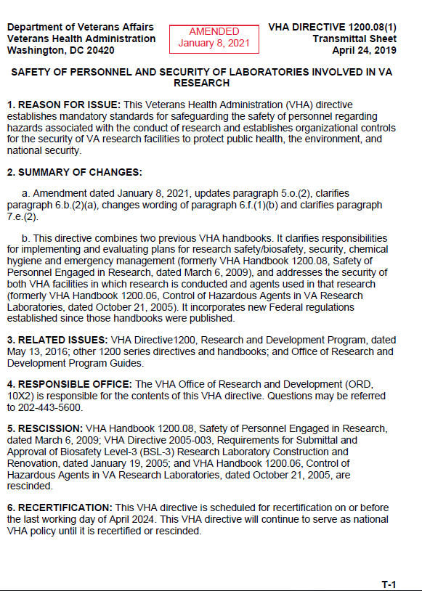
VHA Directive 1200.08(1)

Slide 47
Quick Guide to
VHA Directive 1200.01’s Technical Amendments
Revises Institutional Biosafety Committee’s (IBC’s) recertification requirements and removed requirement requiring use of another VA Facility’s IBC to be in the same community as the relying VA Facility to align with the NIH Guidelines.
Clarifies the SRS liaison member’s status.
Includes minor word revisions to clarify sentences.

Slide 48
Itemization of Technical Amendments
Published on January 8, 2021 to
VHA Directive 1200.08
Description of Amendment: Six revisions are present in the January 8, 2021 technical amendment to VHA Directive 1200.08. The amendments described in detail in the following tables are summarized as follows with revisions highlighted in red.
Paragraph 2: Revised summary of changes.
Paragraph 5.O.(2): Revised triennial review requirement.
Paragraph 6.b.(2)(a): Clarified that liaison member to the Subcommittee on Research Safety (SRS) from the R&D Committee is a non-voting member of SRS.
Paragraph 6.c.(1): Clarified the policy by adding the word “any”.
Paragraph 6.f.(1)(b): Clarified the policy by using the word “evaluation” instead of “assessment”
Paragraph 7.e.(2): Removed the geographic requirement to align with NIH’s removal in the NIH Guidelines for use of external IBCs.

Slide 49
VHA Directive 1200.08’s Technical Amendments:
Alignment with Revised NIH Guidelines
Issue requiring clarification: VHA Directive 1200.08 was published on April 19, 24, 2019. The NIH Guidelines for Research Involving Recombinant or Synthetic Nucleic Acid Molecules (NIH Guidelines) were revised on April 26, 2019.
Resolution:
  Revised policy to remove the ORD policy requiring a VA Facility to rely upon another VA Facility’s IBC in the same community.
  Revised policy requiring IBC annual recertification to periodic review as defined in written policies and procedures.
  More technical amendments are pending to align VHA 1200.08.
  Applicable amendments
    Paragraph 5.O.(2)
    Paragraph 7.e.(2)

Slide 50
VHA Directive 1200.08’s Technical Amendments:
SRS Membership
Issue requiring clarification: Confusion exists whether the liaison member from the facility’s R&D Committee Ex-Officio members [of SRS] must include (a) a liaison member from the facility R&D Committee (non-voting)”.
  The original policy statement in VHA Directive 1200.08, Paragraph 6.b.(2) regarding the referenced ex-officio member of SRS stated that: “Ex-Officio members [of SRS] must include (a) a liaison member from the facility R&D Committee (non-voting)”.
  Multiple queries have been received asking whether the intent of the policy was for the ex-officio member in Paragraph 6.b.(2) to be voting or non-voting members of SRS based on the placement of the “(non-voting)” phrase.

Slide 51
VHA Directive 1200.08’s Technical Amendments:
SRS Membership
Issue requiring clarification: Confusion exists whether the liaison member from the facility’s R&D Committee Ex-Officio members [of SRS] must include (a) a liaison member from the facility R&D Committee (non-voting)”.
Resolution:
  Revised policy to clarify that the liaison member to the SRS from the R&D Committee will be a non-voting member of SRS. It is an ex-officio role.
  Applicable amendment
    Paragraph 6.b.(2)(a)

Slide 52
Summary
Technical amendments do not substantially change existing policy,but are intended to clarify existing policy or remove policy that has never been implemented.
Expect additional technical amendments in the future to clarify existing policies, but major revisions in VHA Directives 1200.01 and 1200.05 are already planned.

Slide 53

Questions

Slide 54
References
Description of Amendment #1 (January 8, 2021) to VHA Directive 1200.01: Research and Development Committee
Description of Amendment #2 (January 8, 2021) to VHA Directive 1200.05 (va.gov)
Description of Amendment #1 (January 8, 2021) to VHA Directive 1200.08 (va.gov)
Memorandum from the DEAN-DUSH: Delay in Implementation of VHA Directive 1200.01 Policies for Three Specific Areas until January 31, 2021 (July 29, 2020)
VHA Publications (va.gov): Directives
ORD Toolkits (va.gov)

Slide 55
References
NIH Guidelines for Research Involving Recombinant or Synthetic Nucleic Acid Molecules (NIH Guidelines) - April 2019
ORD’s Technology Transfer Program: Forms, Templates and Model Agreements (va.gov)

Slide 56
Availability of Recording
A recording of this session and the associated handouts will be available on ORPP&E’s Education and Training website approximately one-week post-webinar
An archive of all ORPP&E-hosted webinars can be found here: https://www.research.va.gov/programs/orppe/education/webinars/archives.cfm

